Slide 1
Review of CAR# 163915982

Slide 2
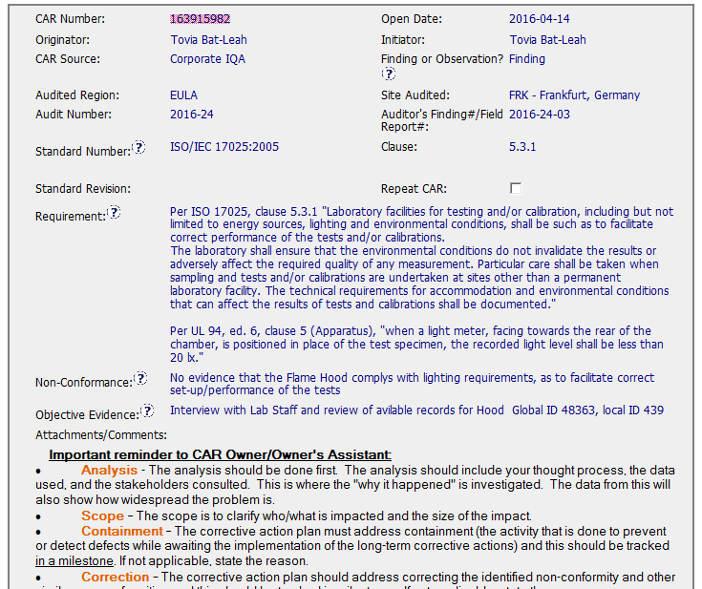
Open date on the day of the audit
The requirement is applicable, however, can we consider the admin effort of multiple CAR’s?

Slide 3
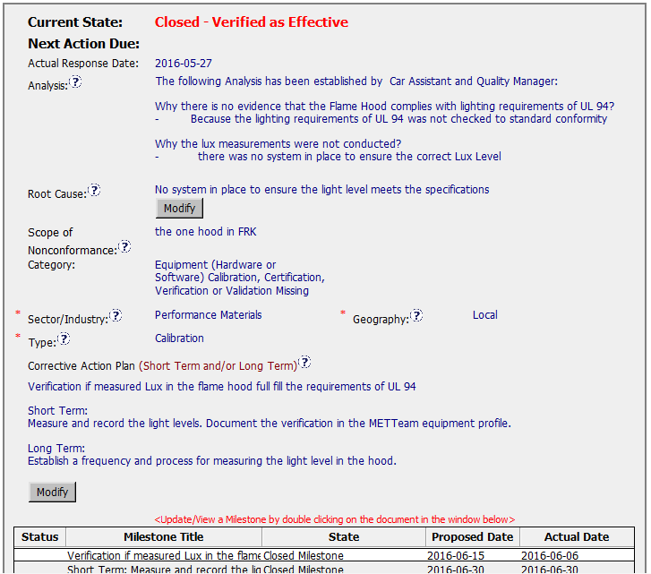
30 minute meeting
Actually applied to all flame hoods
Analysis is not detailed enough – more questions needed to be addressed

Slide 4
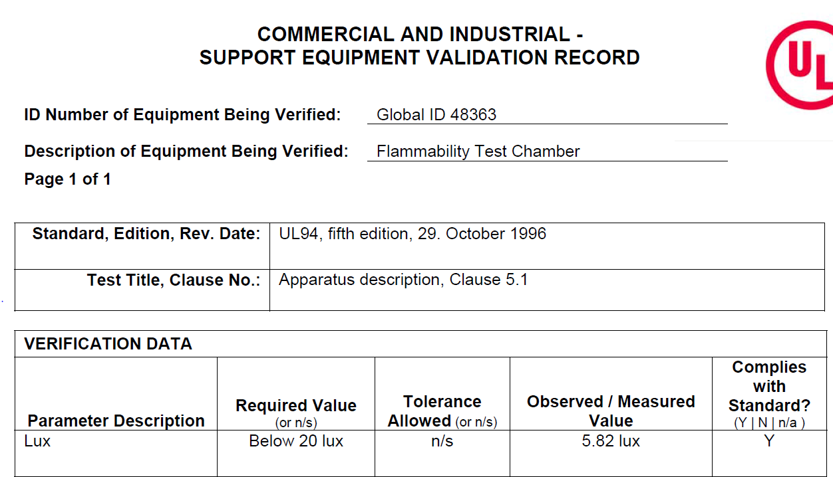
Observed value far below minimum required value

Slide 5
Information not required for Observation
Clear short term and long term actions

Slide 6
CAR 163915982 – CBS Check
CBS Requirements | Meets | Needs Improvement | N/A | Comments
Integrity | X |  |  | Good: CAR did not need any extensions and was completed within appropriate timeframe Improve: Date when CAR was inputted into the database from closing meeting ; standard number and category of standard could be improved.
Competitiveness | X |  |  | Observation did not need root cause. Milestone addressed the needed information to satisfy the observation.
Collaboration |  | X | X | I believe improved communication could have prevented much non value added work

Slide 7
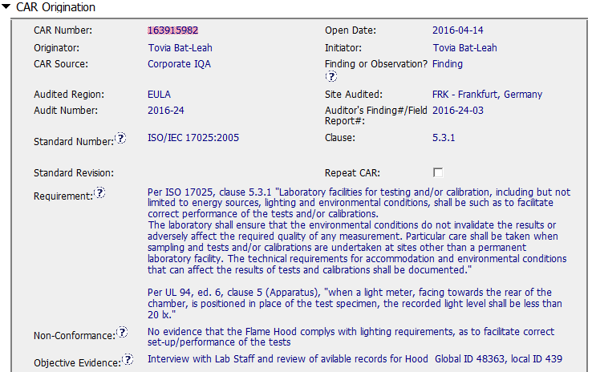
CAR 163915982
Finding - CAR
Background: Corporate IQA - “Light level shall be less than 20 lux” was not confirmed for UL 94 flame testing.

Slide 8
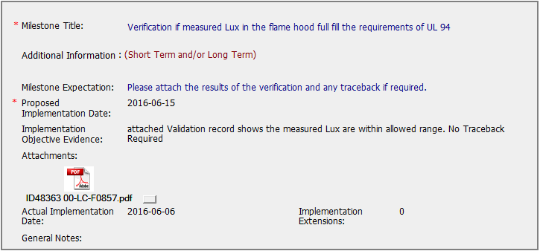
CAR 163915982
Excellent (1)
(C) Corrective actions fix the objective evidence and other problems found.
Meet UL Value:
COMPETITIVENESS
Meet CBS:
Achieve Business Results
Excellent (1)
Verification Record provided and no traceback.

Slide 9
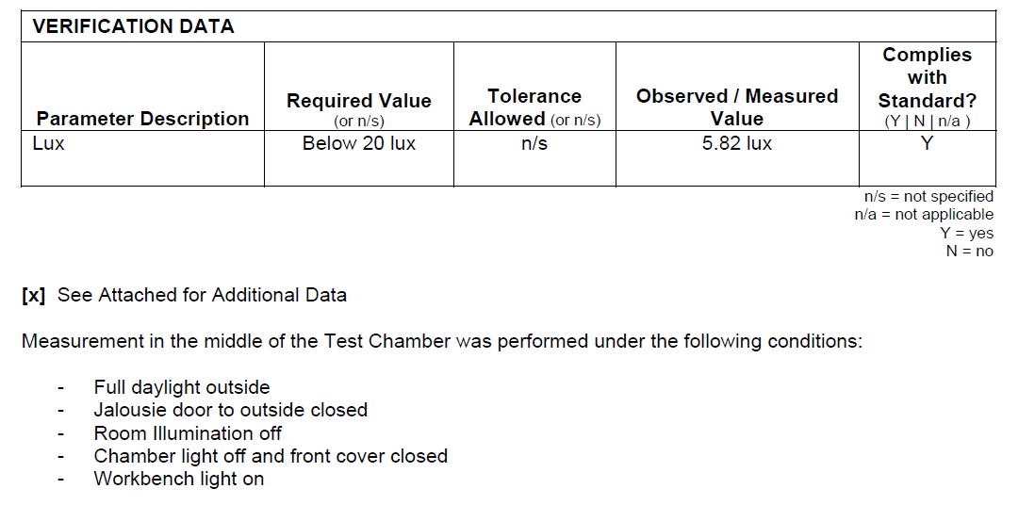
CAR 163915982
Excellent (1) –
Assume flame test only conducted while meeting all 5 conditions.

Slide 10
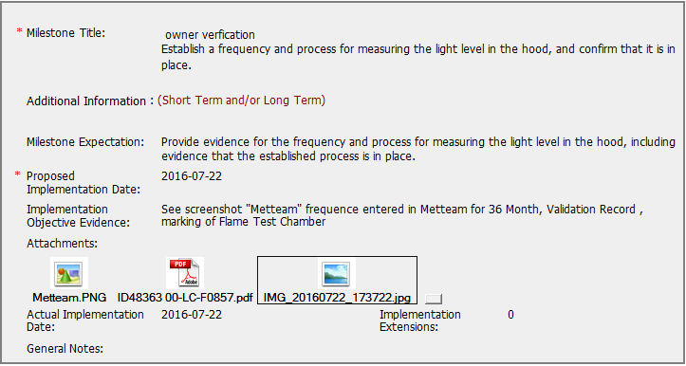
CAR 163915982
Suggestion (1) – Can find the frequency is 36 months, but not sure what’s the “process” due to lack of explanation or SOP.
Suggestion (1)
Suggestion to make
(C) Corrective actions address entire root cause
Meet UL Value:
COMPETITIVENESS
Meet CBS:
Achieve Business Results

Slide 11

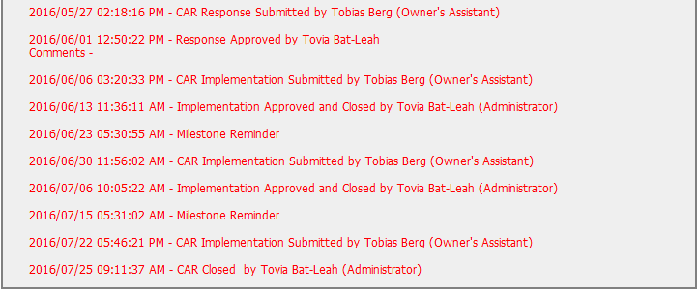
CAR 163915982 History Summary
Excellent (2)
(C) Extensions are within requirement (<30 days, 3 or less)
(T) Acts on CARs within required timeframe
Meet UL Value:
INTEGRITY
Meet CBS:
Initiative & Decision Making
Analyzing & Problem Solving
Excellent (2-1)
Extension are within requirement (< 30 days)
Excellent (2-2)
Act on CAR in required timeframe

Slide 12
CAR 153915982 – CBS Check
CBS Requirements | Excellent | Moderate | Need Improve | N/A
(C) Extensions are within requirement (<30 days, 3 or less) | √
(T) Most appropriate ‘category’, ‘type’, ‘geography’ are selected | √
(P) Facilitates the handling of disputed CARs |  |  |  | √
(T) Acts on CARs within required timeframe | √
(C) Analysis shows clear path to root cause and scope; stakeholders identified |  | √ with Suggestion
(C) Root cause statement is succinct, reasonable, complete (Shows ‘N/A’ for observations) |  | √
(C) Corrective actions fix the objective evidence and other problems found; address entire root cause and scope. For observations, they do not go beyond fixing the objective evidence | √
(C) Milestones address containment & owner’s verification; completed per milestone expectations |  |  | √ with Suggestion
(P) Verification per requirements |  |  |  | √
(L) Referenced communications are attached as needed |  | √ with Suggestion
(C L) Evidence of communication for overdue/escalated CARs and other pertinent concerns |  |  |  | √
(P) Trains other CAR Champions |  |  |  | √

